Slide 1
HealthGenie Chatbot
Submitted in the partial fulfillment for the award of the degree of
BACHELOR OF ENGINEERING
IN
ARTIFICIAL INTELLIGENCE
Under the Supervision of:
Dr.Alankrita Aggarwal,Associate Professor,Departmnet of Computer Science & Engineering,AIT.Chnadiharh University,Mohali,Punjab(India)
Submitted by:
SHRISHTY GUPTA
20BCS6784
Department of AIT-CSE
DISCOVER . LEARN . EMPOWER

Slide 2
Outline
Introduction to Project
Problem Formulation
Objectives of the work
Methodology used
Results and Outputs
Conclusion
Future Scope
References

Slide 3
Introduction to Project
Healthcare chatbots are an emerging technology that has the potential to transform the way patients interact with the healthcare system.
These chatbots are computer programs that use natural language processing and artificial intelligence to simulate human conversation and provide personalized health advice and support.
My ChatBot “HealthGenie” harness the power of ChatGPT which helps this virtual assistant to effectively understand and respond to a wide array of patient inquiries, provide personalized health information, and offer guidance on various medical topics.

Slide 4
Problem Formulation
Even though a phone call or email might be considered as easy forms of communication with the professionals , they are not always the most effective.
Medical chatbots can answer inquiries regarding prescriptions, appointment scheduling, and other issues. As a result, medical professionals and facilities may relax knowing that questions from patients will be promptly addressed.
Provide 24/7 Access to Healthcare Information: Giving users continuous access to reliable and current healthcare information is one of the main goals of a healthcare chatbot. Users can ask inquiries about signs, conditions, treatments, and general health advice, and they will promptly and accurately receive answers.

Slide 5
Enhance Access to Mental Health Support: Healthcare chatbots' assistance for mental health is a key goal. They can give users a private forum to talk about their mental health, offer coping mechanisms, and, if necessary, direct users to the proper mental health resources or professionals.
Complement and Support Healthcare Providers: Healthcare chatbots are created to supplement the job of healthcare providers by providing consumers with help and information while lightening the workload on healthcare workers. They can help with patient triage, provide fundamental medical knowledge, and guarantee that consumers get quick and accurate advice.

Slide 6
Objectives of the Work
The purpose of ‘HealthGenie’ a healthcare chatbot is to provide an AI assistant which would harness the power of ChatGPT and can effectively understand and respond to a wide array of patient inquiries, provide personalized health information, and offer guidance on various medical topics. The power of ChatGPT lies in its ability to comprehend context, interpret user intent, and generate relevant and coherent responses.

Slide 7
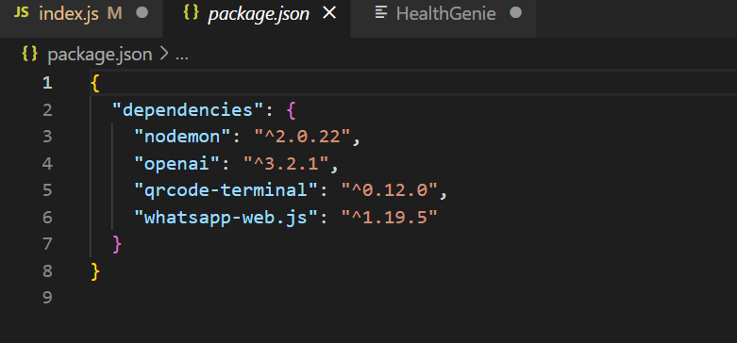
Dependencies used

Slide 8
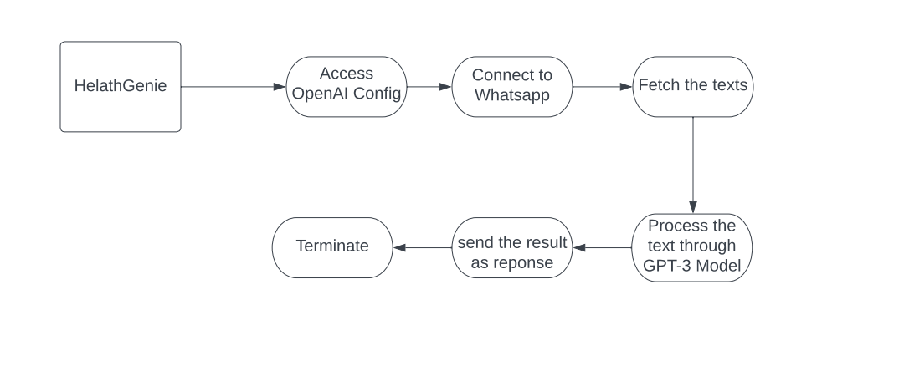
Methodology

Slide 9
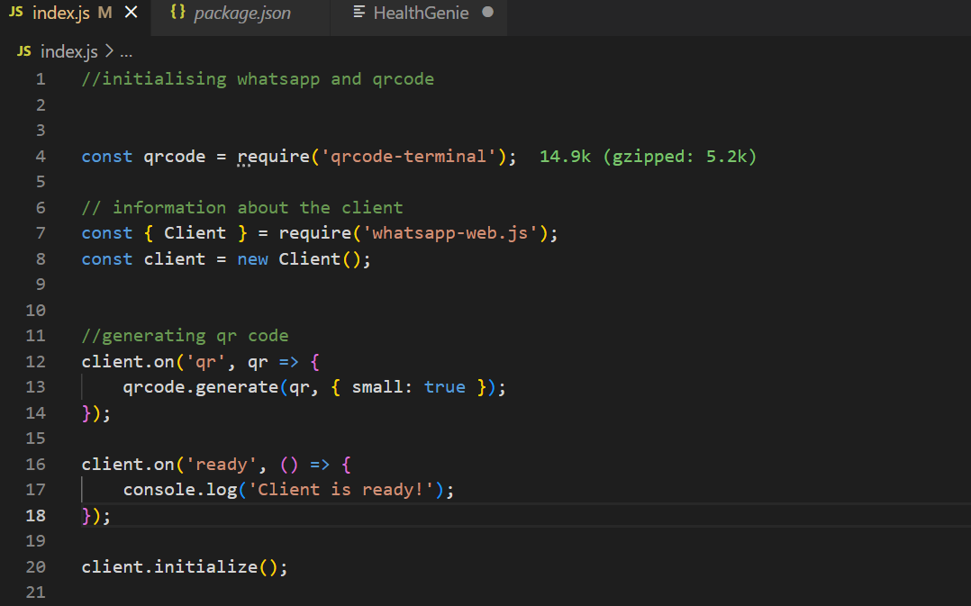
Results and Outputs

Slide 10
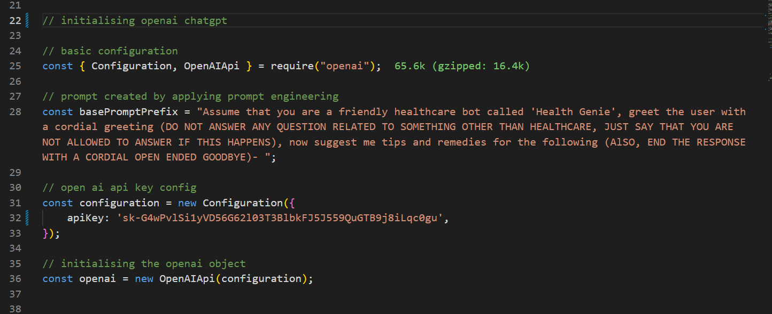

Slide 11
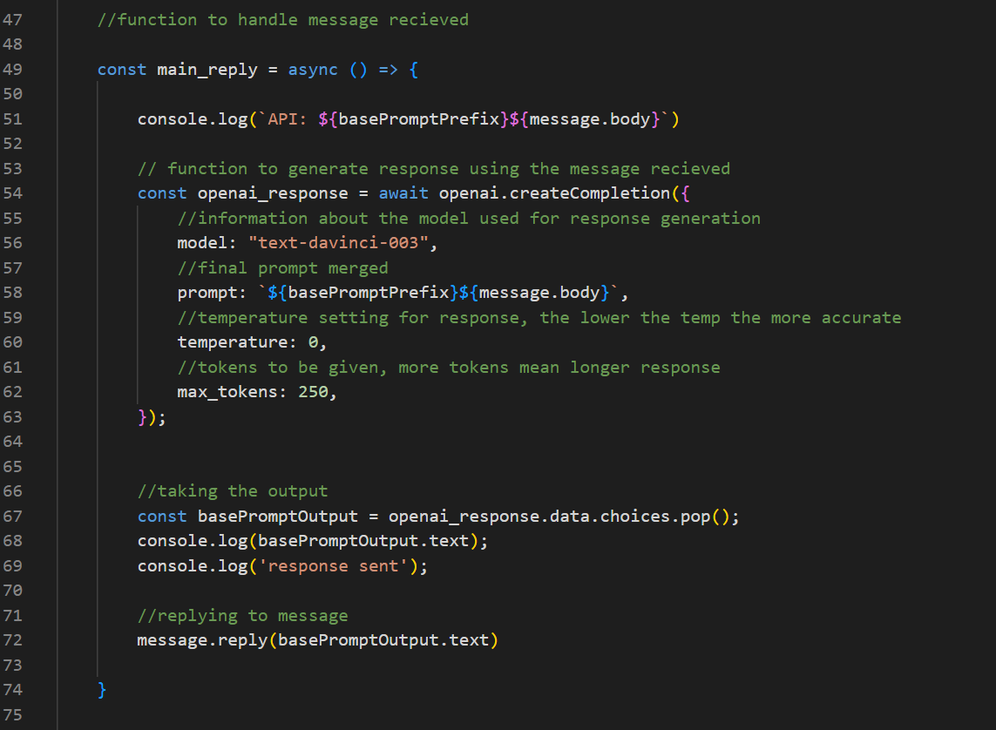

Slide 12
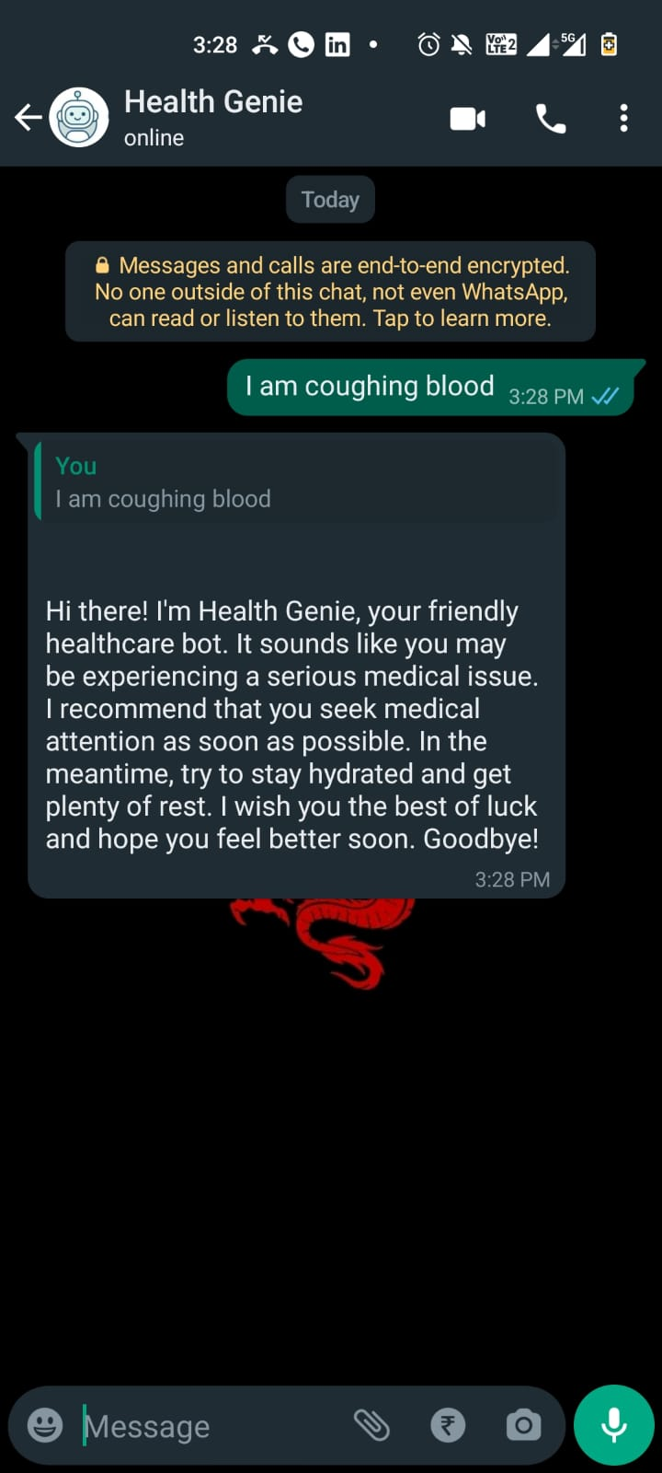
Whatsapp preview

Slide 13
Conclusion
My health care chatbot “Health Genie ” has various advantages in today’s world. The goal of "HealthGenie," a healthcare chatbot, is to give an AI assistant that can successfully comprehend and respond to a wide range of patient enquiries, provide individualised health information, and offer assistance on various medical topics. It does this by utilising the ChatGPT platform. ChatGPT's strength rests in its capacity to perceive context, decipher user intent, and produce pertinent and well-thought-out solutions.

Slide 14
Future Scope
My chatbot “HealthGenie” is a whatsapp bot which harness the power of chatgpt for answering all the user queries.
The future scope of healthcare chatbots is promising and encompasses various exciting possibilities. Here are some key areas where healthcare chatbots are expected to make significant advancements:
Integration with Wearable Devices and IoT: Personalised and real-time health monitoring can be provided by healthcare chatbots through the integration of wearable technology and the Internet of Things (IoT).
Virtual Health Assistants: Chatbots for the healthcare industry have the potential to develop into thorough virtual health assistants. They can act as a one-stop shop for all healthcare requirements, such as appointment setting, medication management, individualised health coaching, and ongoing chronic condition monitoring.
Can be added to a website: If my chatbot is added to a medical clinic website or hospital website it would benefit the organization greatly.

Slide 15
References
https://help.openai.com/en/articles/6654000-best-practices-for-prompt-engineering-with-openai-api
https://openai.com/blog/openai-api

